Slide 1
The Curry-Howard Isomorphism
Introduction
Some Background
A Three-way Correspondence
Reflections

Slide 2


Introduction
An example
Modus ponens
Function application
The Curry-Howard Isomorphism

Slide 3
A Three-way Correspondence
Cartesian Closed Categories
Objects
Morphisms
Terms
Proofs
Types
Propositions
Simply Typed Lambda Calculus
Intuitionistic Propositional Logic

Slide 4


Intuitionistic Logic
Syntactically, reductio ad absurdum (RAA) is not a rule in the natural deduction system of IL.
The law of excluded middle and double negation elimination are no longer axioms.

Slide 5





Simply Typed Lambda Calculus
A family of prototype programming languages
Simply typed lambda calculus with function types
Types
Terms
Three kinds of equivalence
α-equivalence
β-equivalence
η-equivalence

Slide 6
Cartesian Closed Categories
A CCC is a category with the following extra structure:
A terminal object unit with unique arrow One^{A} for every A
Object map ⨉, function ⟨,⟩, and arrows Proj₁ and Proj₂ satisfying Proj_{i}∘⟨f₁, f₂⟩ = f_{i} and ⟨Proj₁∘g, Proj₂∘g⟩ = g
Object map →, function Curry, and arrow App satisfying App∘⟨Curry(h)∘Proj₁, Proj₂⟩ = h and Curry(App∘⟨k∘Proj₁, Proj₂⟩) = k

Slide 7
Encoding Proofs in Typed Lambda Terms
Every proof leads to a type derivation
Every type-derivation brings a well-typed lambda term
Therefore, every proof can be encoded in a well-typed lambda term
assumptions are encoded in type context
proofs of theorems are encoded in closed terms

Slide 8

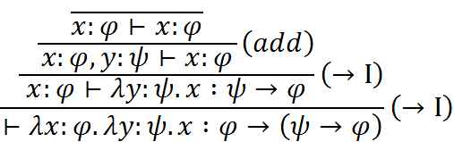
Encoding Proofs in Typed Lambda Terms
Example – Theorem
The proof of theorem is encoded in combinator

Slide 9
Decoding Well-typed Lambda Terms
Every well-typed lambda term uniquely determines a type derivation
Every type derivation leads to a proof (by erasing terms)
By decoding a well-typed lambda term, we obtain a proof
Rebuild the type derivation of the term
Erase all the terms in the derivation

Slide 10
Decoding Well-typed Lambda Terms
Example – Combinator
The proof of theorem is obtained by decoding the combinator

Slide 11
Some Correspondence
Propositions correspond to types
propositional connectives ≌ type constructors
set of propositions ≌ set of simple types
Proofs correspond to terms
natural deduction system ≌ typing rules
normalization ≌ reduction
Some typical questions
proof checking ≌ type checking
provability ≌ inhabitation

Slide 12
A Three-way Correspondence
Cartesian Closed Categories
Objects
Morphisms
Terms
Proofs
Types
Propositions
Simply Typed Lambda Calculus
Intuitionistic Propositional Logic

Slide 13













λ^{unit,×,→} or λ→
CCCs
terminal type
product types
function types
terminal object
products
exponentials
is as expressive as
product ≌ sequence
function ≌
function ≌ and

Slide 14




Interpreting Well-typed Terms as Morphisms
Given a cartesian closed category with some object constants
the interpretation of type expressions
the interpretation of type contexts

Slide 15









Interpreting Well-typed Terms as Morphisms
the interpretation of well-typed terms
Given ,

Slide 16


Soundness
Theorem (Soundness) Given any well typed terms M and N, if , then in every CCC.

Slide 17




Soundness (cont.)
Proof
α-equivalence:
no term-variable name appears in the calculations
β-equivalence:
App∘⟨Curry(h)∘Proj₁, Proj₂⟩ = h
Substitution Lemma
η-equivalence:
Curry(App∘⟨k∘Proj₁, Proj₂⟩) = k

Slide 18


Completeness
Theorem (Completeness) Given any and , there exists a CCC such that if , then .

Slide 19


Completeness (cont.)
Proof
Construct one category from λ→
Objects – sequences of types
[] – terminal object
[σ₁, … ,σ_{m}] – products of [σ_{i}] –
Morphisms – tuples of equivalence classes of terms
is cartesian closed (the most difficult part)
If satisfies , then .

Slide 20
Reflections
A connection between very diverse mathematical subjects
Cartesian Closed Categories
Objects
Morphisms
Terms
Proofs
Types
Propositions
Simply Typed Lambda Calculus
Intuitionistic Propositional Logic

Slide 21
Reflections
The C.H. isomorphism can be extended to stronger logics, more expressive languages and richer categories
First order logic ≌ Dependent types
PCF ≌ Category of domains
…

Slide 22
Reflections
The C.H. isomorphism helps to prove theorems in each field
Q: Is the inhabitation problem in Dependent Types decidable?
A: No, it is undecidable.
Inhabitation ≌ Provability
Dependent Types ≌ First Order Logic
Provability in First Order Logic is undecidable

Slide 23
The Curry-Howard Isomorphism
Thank you for your listening!
Questions?

Slide 24
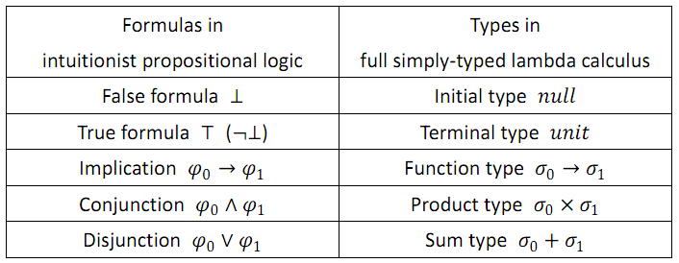
Appendix
Connectives VS. Type Constructors

Slide 25
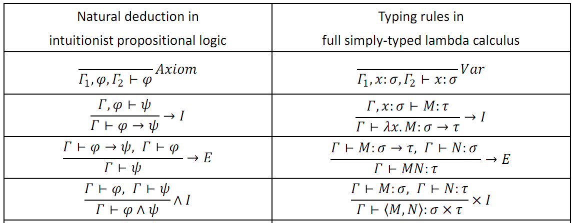
Appendix
Natural Deduction System VS. Typing Rules

Slide 26
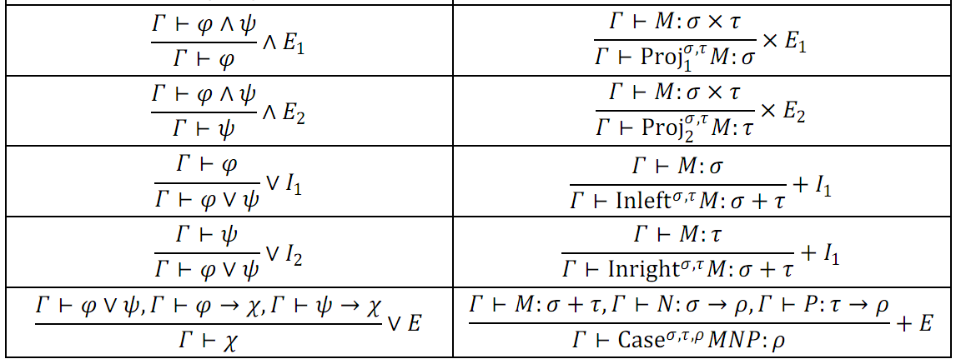
Appendix
Natural Deduction System VS. Typing Rules (cont.)

